Slide 1
Image Caption Generator with CNN and LSTM
Team Members:
Pramod N
Sai Mithun
Jayanth SR
SHARAJ OV
Submitted To:
Selvaraj Poornima
Associate Professor,
CSE

Slide 2
ABSTRACT
For this project, we use CNN and LSTM to become aware of the caption of the image. Image caption generation is a system that comprehends natural language processing & computer vision standards to recognize the connection of the image in English. In this research paper, we cautiously pursue a number of important concepts of photograph captioning and its familiar processes.We also talk about flickr_dataset and CNN used for photo classification.

Slide 3


Image caption generator is a task that involves computer vision and natural language processing concepts to recognize the context of an image and describe them in a natural language like English.
What is Image Caption Generator?

Slide 4
Image Caption Generator Model
1
CNN
2
LSTM

Slide 5
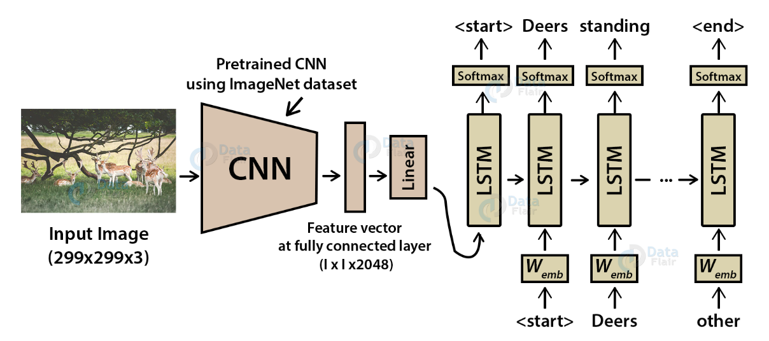
Image Caption Generator Model

Slide 6

Convolutional Neural networks are specialized deep neural networks which can process the data that has input shape like a 2D matrix. Images are easily represented as a 2D matrix and CNN is very useful in working with images.
What is CNN?

Slide 7
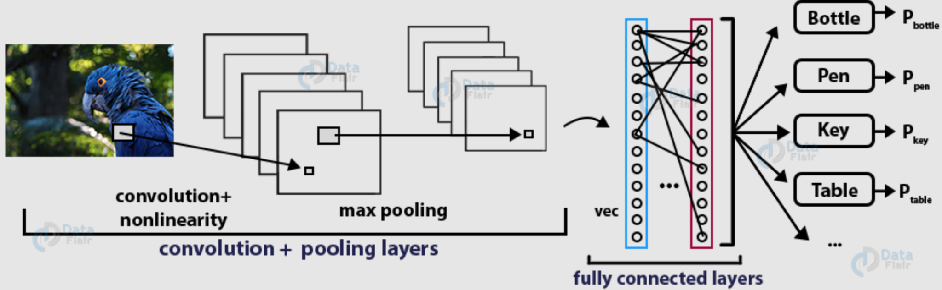
Working on deep CNN

Slide 8
LSTM stands for Long short term memory, they are a type of RNN(recurrent neural network), which is well suited for sequence prediction problems. LSTM can carry out relevant information throughout the processing of inputs and with a forget gate it discards non-relevant information.
What is LSTM?

Slide 9
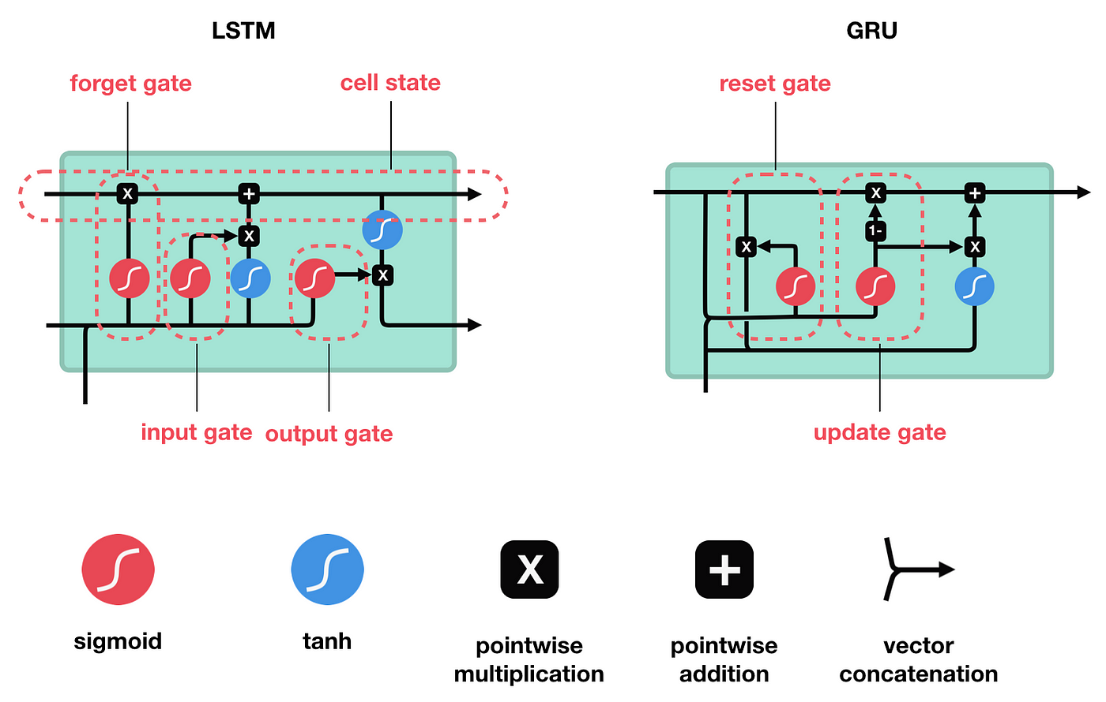

LSTM cell structure

Slide 10
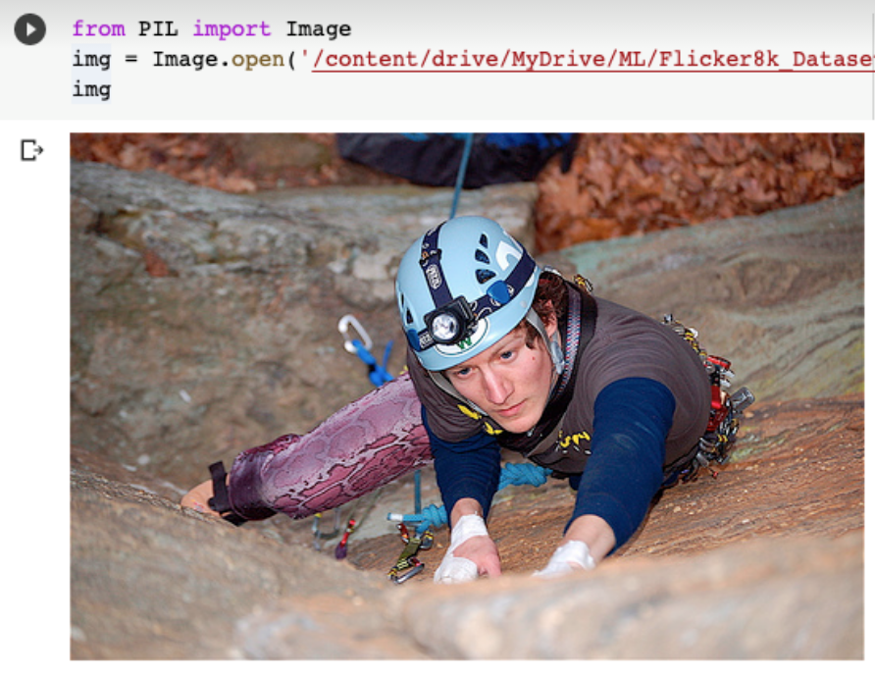
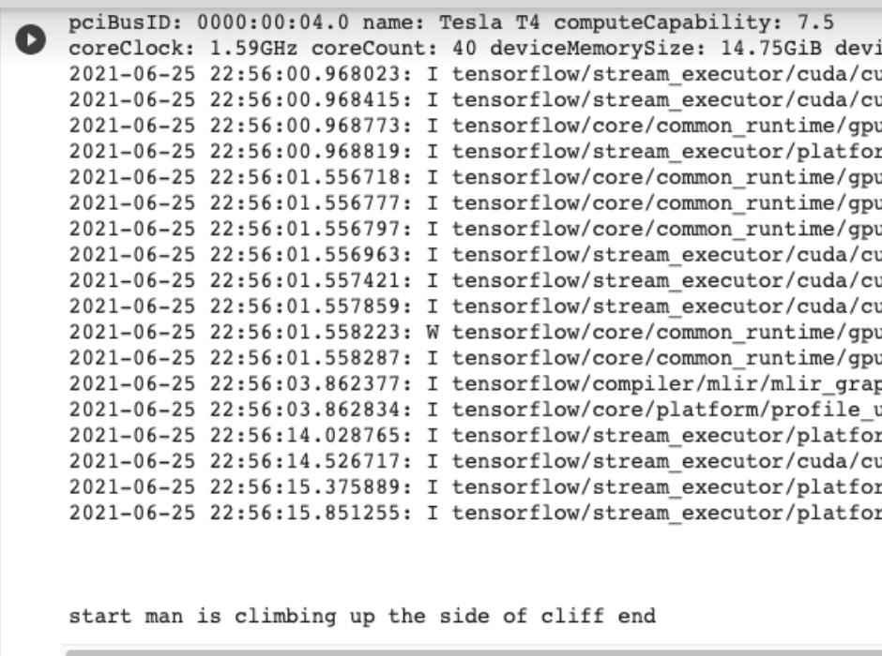
Result

Slide 11
CONCLUSION
The CNN-LSTM model was built on the idea of
generating the captions for the input pictures. This
model can be used for a variety of applications. In
this, we studied about the CNN model, LSTM models, and in the end we validate that the model is generating captions for the input
pictures.

Slide 12


